Slide 1
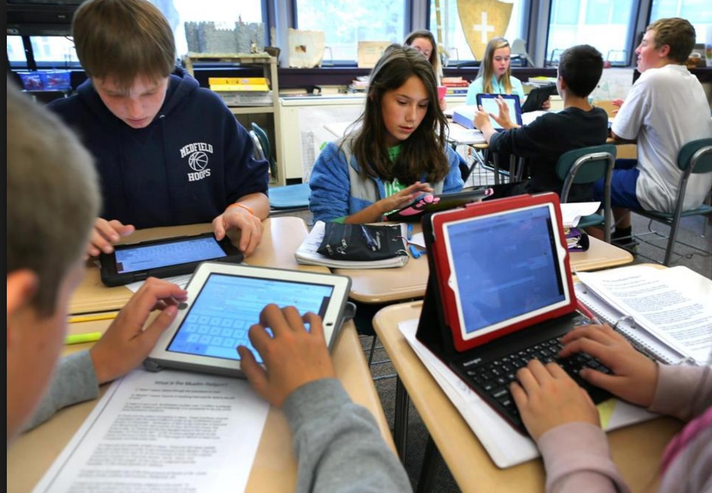

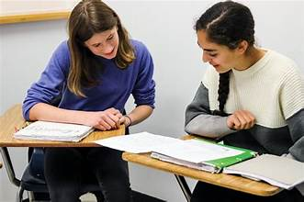



Retention Rates
Ava Barnes, Cailin Werner, Thomas Quebedeaux
UNIV 100-044-202420
Fall 2023
Retention Rates
“of the 1,233 personal finance students, 1,078 achieved this criterion of academic success…” (Eichelberger, et al., 2019).
https://www.swmich.edu/media/website/content-assets/images/general-images/satisfaction-chart.jpg
https://www.bing.com/ck/a?!&&p=e42a4a54f93b1d6eJmltdHM9MTcwMDUyNDgwMCZpZ3VpZD0yYzBiN2I1ZS1mYmVhLTZhMDQtM2ZiMC02ODk0ZmFlMjZiMWMmaW5zaWQ9NTcyMg&ptn=3&ver=2&hsh=3&fclid=2c0b7b5e-fbea-6a04-3fb0-6894fae26b1c&u=a1L2ltYWdlcy9zZWFyY2g_cT1wZW9wbGUgaGFwcHkgZ3JhZHR1YXRpbmcmRk9STT1JUUZSQkEmaWQ9NjY1ODA5NTM5OUQ5QjQyMEYyNUE0MUUzNDkzMEREMUU3MDQ1RURENA&ntb=1
Online Vs In-person learning
Major satisfaction
“Students must be able to develop
self-management and self-directed learning; this means, taking a more active role by selecting strategies and techniques to execute their work more effectively, being able to diagnose their own learning needs, setting goals, and assessing their learning outcomes.” (Hernández-Coló, M. R., & Hernández, X.)
A student’s personality plays into their retention rates, as the way a student expresses themselves connects to the classes they will enjoy. aa students enjoy what they’re doing, retention rates will increase.
https://dalton100.org/2018/09/24/14-peer-tutoring/
h
https://www.bing.com/images/search?view=detailV2&ccid=zGDQ%2fyoL&id=4682409B13A9FA3C583A61904849766F8F48AA44&thid=OIP.zGDQ_yoLD4Rvpw8o1GHurgHaD4&mediaurl=https%3a%2f%2ffiles.oyaop.com%2fuploads%2f2018%2f10%2fScreen-Shot-2018-10-12-at-1.06.58-PM.png&cdnurl=https%3a%2f%2fth.bing.com%2fth%2fid%2fR.cc60d0ff2a0b0f846fa70f28d461eeae%3frik%3dRKpIj292SUiQYQ%26pid%3dImgRaw%26r%3d0&exph=315&expw=600&q=college+majors+icon&simid=607990812188765841&FORM=IRPRST&ck=CF468828BE38B0CA6070ED1BE87DE554&selectedIndex=13
https://www.bing.com/images/search?view=detailV2&ccid=ZcBTYcGe&id=E213C563029C29831230573726C41629D83FE096&thid=OIP.ZcBTYcGeFSBoVJQXHRCswwHaE7&mediaurl=https%3a%2f%2fthumbs.dreamstime.com%2fb%2fvideo-meeting-laptop-screen-zoom-app-call-icons-group-people-online-communication-female-hands-keyboard-181323455.jpg&cdnurl=https%3a%2f%2fth.bing.com%2fth%2fid%2fR.65c05361c19e1520685494171d10acc3%3frik%3dluA%252f2CkWxCY3Vw%26pid%3dImgRaw%26r%3d0&exph=532&expw=800&q=zoom+home+screen&simid=607987629655278793&FORM=IRPRST&ck=7D1824F02AB6F64FF6BD4E516A01D4DC&selectedIndex=75
https://www.vecteezy.com/vector-art/131679-a-pile-of-money

