Slide 1


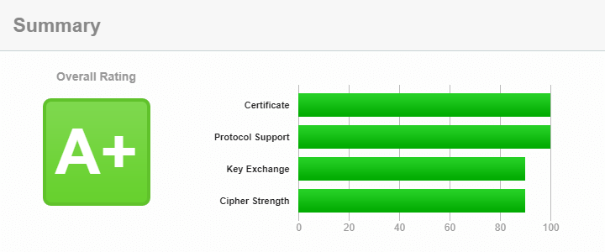



Online vs In-Person Learning
Benjamin Ragusa, Alejandro Call, Devin Knowles
Fall 2023 - UNIV 100 Section 044
"The results showed that the students taking the course online scored a higher score on active learning methods."
"Online and face-to-face learning had very similar results in terms of wanting to learn, however the online group of students had a lower chance of missing classes"
"Online education has demonstrated a notably positive influence on students' attitudes toward learning"

